Slide 1

Ten Years with the Wolf Amendment
Implications and Responsibilities on JPL Activity with China
Office of the Chief Scientist (OCS) Import/Export Control Office (I/ECO)
Document Review Services (DRS) Office of General Counsel (OGC)
August 23, 2021

Slide 2
Objective of Town Hall
Review Wolf Amendment and its implications
Identify manager and employee responsibilities
Identify Points of Contact and resources at JPL for questions
Get feedback from managers to help improve communication

Slide 3
What is the Wolf Amendment?
Since 2011, as a result of an act of Congress, NASA has been prohibited from funding any work that involves bilateral participation, collaboration, or coordination with the government of China (PRC) or any Chinese-owned company or entity, regardless of whether any funds are exchanged. Multilateral activities (involving additional countries) are generally permitted.
This restriction includes Hong Kong and Macau
(NASA has additional restrictions affecting relationships with Chinese citizens separate from the Wolf amendment)

Slide 4
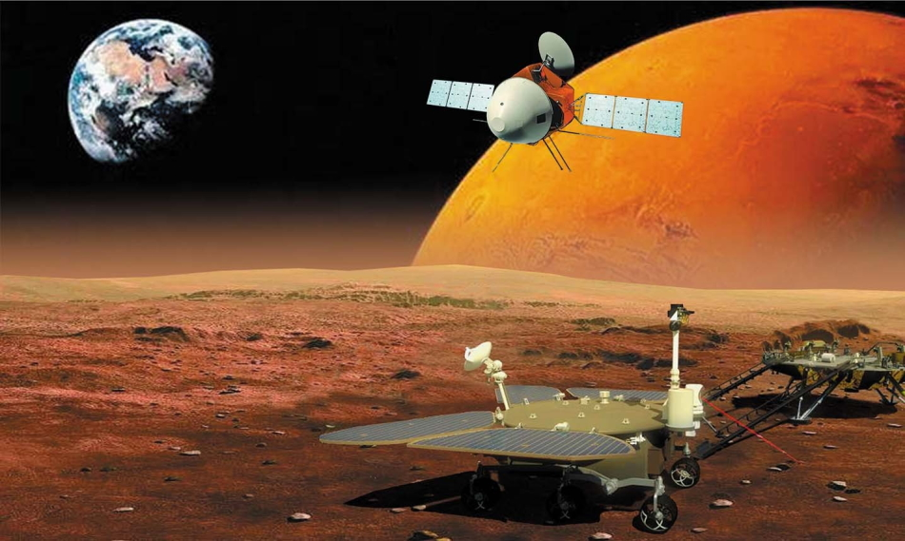

Congressional Approval Required for Information Exchange
NASA obtained congressional approval (per the Wolf Amendment, Section 526(c) and (d)) to exchange information with the China National Space Administration (CNSA) on the orbit of the Tianwen-1 as part of efforts to avoid any collisions with other spacecraft orbiting Mars.
  https://spacenews.com/nasa-exchanged-data-with-china-on-mars-orbiters/
This Photo by Unknown Author is licensed under CC BY-NC-ND
This Photo by Unknown Author is licensed under CC BY

Slide 5
JPL Activities Affected
Research collaborations
Authoring or coauthoring papers intended for publication in scientific journals or meeting proceedings
Authoring or coauthoring presentation materials for conferences or meetings (including virtual conferences/meetings)
Proposals
Hosting of Chinese Visitors/Researchers
Data Exchange
Equipment Exchange
Communications, including Email Correspondence (JPL does not allow email to or from .cn email addresses)
Procurements
Task Plans and Task Orders

Slide 6
Manager & Employee Related Responsibilities
Complete annual mandatory Import/Export Compliance training, which contains training modules relevant to Wolf Amendment
Review guidance on I/ECO website; managers should help disseminate information to their employees
Ask questions before you engage in activities that might be prohibited:
  I/ECO for general questions
  OCS for research related questions
Submit all authored and/or coauthored materials intended for unlimited external public release to the Unlimited Release System (URS) for review and clearance prior to release to help identify/stop possible problems

Slide 7
I/ECO, OCS and OGC Roles
I/ECO provides guidance on what activities are permitted and prohibited by the Wolf Amendment
  Export training includes information regarding the China bilateral restrictions
  Detailed guidelines are on the I/ECO website
  OGC provide additional guidance on more complex bilateral issues
OCS is the go-to place for researchers to seek clarification on research related questions
I/ECO, OGC and OCS coordinate on matters of disclosure to NASA of potential incidents of violations by JPL
This Photo by Unknown Author is licensed under CC BY

Slide 8
DRS Role
Document Review Services will
Issue URS record determination, either cleared for unlimited external release, or disapproved and provide justification
Facilitate conversations with applicable management and reviewing orgs/SMEs to resolve and/or clarify determinations
  Document Review provides a check of evidence of a collaboration, but measures should be taken to avoid bilateral collaboration in the first place, regardless of whether it leads to publications
Coordinate with I/ECO as a Subject Matter Expert (SME) when material is found to contain export controlled information, or other categories of restricted information or content, including China restrictions

Slide 9
Important Distinctions
The Wolf Amendment is separate from export control – it does not matter if you are only working on science. The Wolf Amendment affects bilateral activities between JPL and China, regardless of export control requirements
Dual affiliation – Does the collaborator have an affiliation with a Chinese institution in addition to a US (or another country’s) institution? If so, interactions with the dual-appointee would be considered bilateral
Co-authorship counts! Are there only U.S. and Chinese institutions participating in the effort?
It is not considered a multilateral activity if there is an Italian, Canadian, and American, all from U.S. institutions, and a representative from a Chinese institution

Slide 10
Examples of Allowed Interactions/Activities
Interactions with Chinese nationals enrolled as students in American universities with tuition paid by their families
Interactions with Chinese nationals appointed as postdocs by an American university or research lab if their appointment is not funded by the Chinese government or industry
Participation at Conferences open to the international community are multilateral activities, even though specific sessions might involve speakers/chairs and audience from China and the US only. Presentations/attendance at such sessions are ok.

Slide 11
Guidelines for Data Access/Exchange
JPL scientists who are part of international science teams may accept Chinese science data through group data archives because international teams are multilateral and their activities are therefore not prohibited
JPL researchers are not allowed to enter into any agreement with Chinese organizations to obtain access to data; that is, a JPL researcher may not sign or orally agree to any contract or agreement. If access can be obtained without such agreement, or through the data archives of multilateral groups that include China as a member, then the activity is permitted
JPL researchers may use Chinese data (for example, from ground stations for validation of Earth-orbiting science instrument data products) if the data is publicly available

Slide 12
Email Communications
JPL Cybersecurity has determined that we cannot write emails to or receive emails from .cn addresses
JPLers who are part of a multilateral activity involving colleagues with a .cn email address need to rely on a member of such multilateral activity (example, a colleague at a US university or foreign institution other than China) to handle such communications (to and from)
JPLers cannot use their personal email address to communicate bilaterally with people with .cn email addresses

Slide 13
Recent JPL China Bilateral Incidents
Multilateral activity where JPL Employee replied only to Chinese colleagues via personal email address (Cybersecurity restricts Chinese websites and email addresses).
JPL Employee co-authored a bilateral paper and did not submit the document to URS prior to publication.
JPL Employee co-authored a bilateral paper relevant to his completed doctoral research incorrectly using their JPL affiliation. (byproduct of graduate research)

Slide 14
Resources: Guidance on China Restrictions
Guidelines were developed by I/ECO, OCS, OGC, and other members of the Export Compliance Council (ECC), per direction of Larry James.
  -https://exportcompliance.jpl.nasa.gov/guidance/nasa-china-guidelines/
The guidelines incorporate FAQ developed by NASA HQ nearly a decade ago for ROSES.
  -https://science.nasa.gov/researchers/sara/faqs/prc-faq-roses

Slide 15
POCs for Guidance and Reporting
I/ECO
Rachel Skinner, Manager
OGC
Chantal D’Apuzzo, Associate General Counsel
OCS
Cinzia Zuffada, Associate Chief Scientist
DRS
Janette Beas, Group Lead

Slide 17
Public Law Language
Section 1340 of the Department of Defense and Full-Year Continuing Appropriations Act, 2011, Public Law No. 112-10 reads:
  SEC. 526. (a) None of the funds made available by this Act may be used for the National Aeronautics and Space Administration (NASA), the Office of Science and Technology Policy (OSTP), or the National Space Council (NSC) to develop, design, plan, promulgate, implement, or execute a bilateral policy, program, order, or contract of any kind to participate, collaborate, or coordinate bilaterally in any way with China or any Chinese-owned company unless such activities are specifically authorized by a law enacted after the date of enactment of this Act.
  (b) None of the funds made available by this Act may be used to effectuate the hosting of official Chinese visitors at facilities belonging to or utilized by NASA.
  (c) The limitations described in subsections (a) and (b) shall not apply to activities which NASA, OSTP, or NSC, after consultation with the Federal Bureau of Investigation, have certified—
  (1) pose no risk of resulting in the transfer of technology, data, or other information with national security or economic security implications to China or a Chinese-owned company; and
  (2) will not involve knowing interactions with officials who have been determined by the United States to have direct involvement with violations of human rights.
  (d) Any certification made under subsection (c) shall be submitted to the Committees on Appropriations of the House of Representatives and the Senate, and the Federal Bureau of Investigation, no later than 30 days prior to the activity in question and shall include a description of the purpose of the activity, its agenda, its major participants, and its location and timing.

